Slide 1
Data Mining
Student Name: Saif Kamal Salim Haddad.
Student Id: 21110214.
Section number: Section (2).

Slide 2
Overview
Historical background.
Theoretical background.
Tools

Slide 3
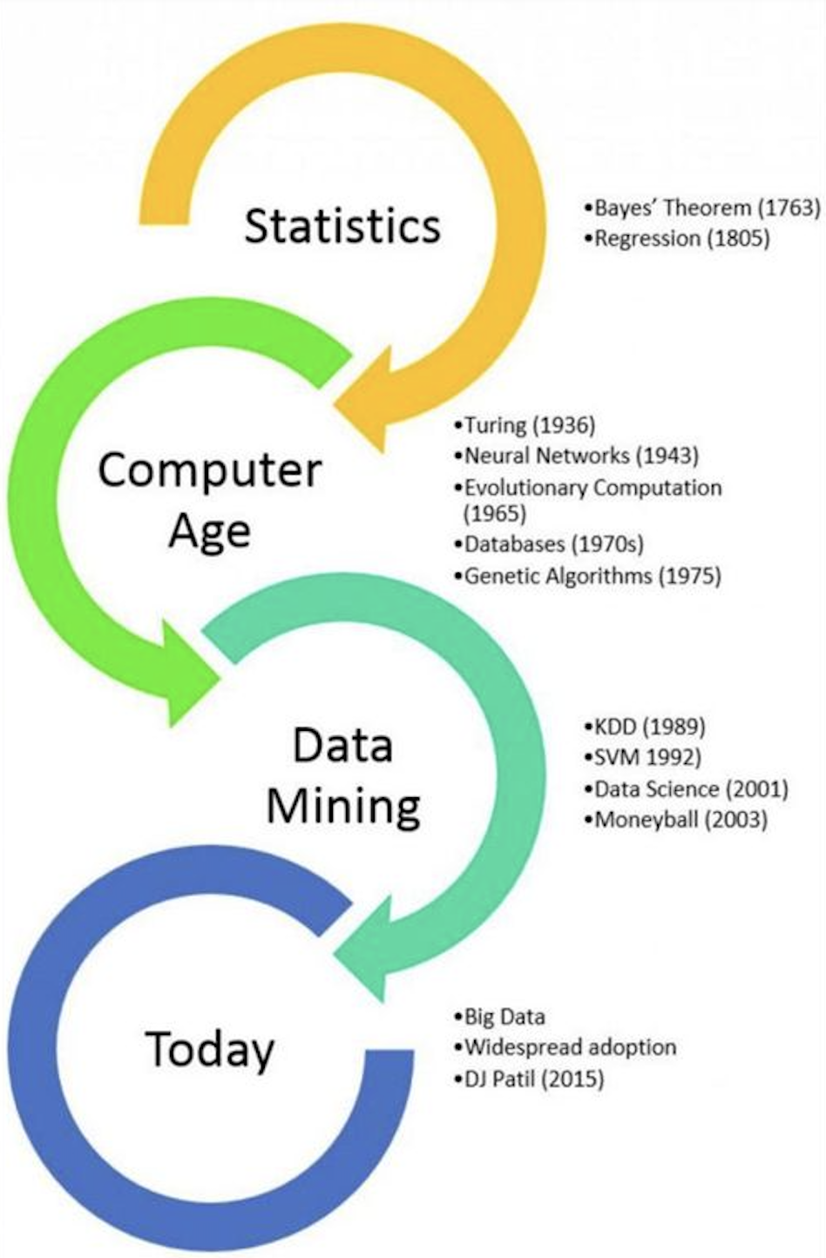
Historical background

Slide 4
Statistics (Theoretical science) 1600 - 1950
This period was the birth of the theoretical models that guide the experiments.
1- Bayes theorem 1763: It was formulated by Thomas Bayes and this paper was published after he died, this theorem connects present probability to previous probability and It enables a good understanding of complicated things based on estimated probabilities,
2- Regression analysis 1805:- Adrien-Marie Legendre and Carl Friedrich Gauss were the first two people who used regression to calculate the orbits of bodies (planets and comets) around the Sun, this regression analysis aims to identify the relationships between variables and The technique employed in this case is the least squares approach.
(Suanfazu et al., 2021) (Exastax, 2017) (bootcamp.rutgers, 2021)

Slide 5
Computer age 1950 - 1990
In this period everything was converted to simulations because of the complexities in math models
1- Universal machine 1936: it can carry out calculations similar to those done by current computers.
2- Neural networks 1943: They present the concept of a neuron in a network activity and Every neuron has three functions: input receiving input processing, and output generation.
3- Evolutionary programming 1960: Lawrence J. Fogel founded the Decision Science company for application evolutionary programming in business applications and It was the first company that apply evolutionary programming to solve real-world issues.
4- Databases 1970: Design an upgraded database management system that can store and retrieve big data sets.
(Suanfazu et al., 2021) (Exastax, 2017) (bootcamp.rutgers, 2021)

Slide 6
The birth of data mining 1989 - 2007
1- Knowledge Discovery in Databases (KDD) 1989: it was the first time that data mining has been studied as a separate subject, and in that time KDD was the whole process and data mining is a part of this process.
2- Support Vector Machines (SVM) 1992: It has the ability to handle complicated data sets greatly improving the concept of data analysis also SVMs are an essential tool in data mining, supporting tasks related to regression and classification in the general KDD process.
3- Moneyball Revolution Book 2003: showed how data mining may be used in baseball team leadership.
(Suanfazu et al., 2021) (Exastax, 2017) (bootcamp.rutgers, 2021)

Slide 7
Today (Big Data and Data Science) 2010 - 2022
2010 : The concept of Big Data became the center of data mining in 2010, and showing the potential and difficulties involved with analyzing large datasets.
2015: DJ Patil was chosen as the United States' first Chief Data Scientist in 2015, a step that emphasized the significance of data science on a national level. There have been more and more practical applications for machine learning, particularly deep learning.
2016: Artificial Intelligence (AI) and Big Data started merging together more and more.
2018: signified a change in emphasis towards ethical issues, data protection regulations (such as GDPR), and the proper application of artificial intelligence.
2019: The growing amount of immediate information was made easier by the emergence of IoT devices.
2011 – 2012: Distributed processing and storage have gained popularity due to tools like Apache Hadoop and its ecosystem.
2013 – 2014: The release of Apache Spark, which provides quicker processing and more dynamic data analysis capabilities, marked a further advancement in big data technology.
(Suanfazu et al., 2021) (Exastax, 2017) (bootcamp.rutgers, 2021)

Slide 8
Today (Big Data and Data Science) 2010 - 2022
2020: Cloud computing giants like AWS, Google Cloud, and Azure came to popularity by providing scalable options for analytics, processing, and data storage.
2021: Platforms and groups have developed to become more approachable, with the goal of enabling people who are not experts to employ data analytics. The focus was on visualization tools, self-service analytics, and reducing big data jobs into simpler activities.
Now: Automation and predicts that are more accurate are being made possible by ongoing advancements in AI and machine learning algorithms.
Now: Edge computing is becoming more crucial as the Internet of Things expands because it can process data closer to its source, resulting in quicker insights and actions.
(Suanfazu et al., 2021) (Exastax, 2017) (bootcamp.rutgers, 2021)

Slide 9
Theoretical background

Slide 10

Theoretical background of data mining:
Data mining: is the process of employing a combination of statistical, computational, and machine learning approaches to find patterns, correlations, trends, and relevant information from big collections of data. Data mining can apply to several data kinds, including text, dates, and numbers, in contrast to text mining, which is only focused on textual data.
(Stedman & Hughes, 2021) (Center et al., 2000)

Slide 11
Data mining process:
Data Collection and Preparation: Reliable and relevant information are essential for accurate analysis.
Data Exploration and Transformation: It's critical for understanding the basic elements of the data.
Pattern Discovery: Finding patterns that are not immediately apparent is the core of data mining.
Model Building and Validation: Using algorithms to analyze data and find patterns or forecast future trends is the process of building models.
(Stedman & Hughes, 2021) (Center et al., 2000)

Slide 12
Techniques used in data mining:
Statistics and Probability Theory:
assistance in understanding of data distributions and the application of statistical models for data-driven conclusions and predictions.
1
Machine Learning:
it is one of the bases of data mining.
2
Database Systems: Working with huge datasets that are kept in databases is a common part of data mining. so it is very important to understand database systems.
3
Data Visualization:
In data mining, effective visualization techniques are essential to achieving comprehensible and useful findings.
4
Ethics and Privacy:
A crucial component of the topic is knowing the effects of data mining on privacy and creating techniques for ethical data mining.
5
(Stedman & Hughes, 2021) (Center et al., 2000)

Slide 13
Applications of Data Mining:
Business and Marketing
Finance
Healthcare
Science and Engineering
(Stedman & Hughes, 2021) (Center et al., 2000)

Slide 14
Why do we use Data mining
Decision-Making
Predictive Analysis
Improving Experiences for Customers
Improving Operations and Efficiency
(Stedman & Hughes, 2021) (Center et al., 2000)

Slide 15
Chalanges in data mining:
Data Quality: Incorrect decisions might result from poor data quality.
Complex and Large Data: A large amount of computing power is needed to handle and process large datasets.
Privacy and Security: Ensuring that personal privacy isn't damaged by data mining techniques.
(Stedman & Hughes, 2021) (Center et al., 2000)

Slide 16
What data mining willing for futer :
Mixing machine learning and artificial intelligence
A stronger focus on big data
More Advanced Tools for Visualization
Pay Attention to Privacy and Ethical Issues
Quantum Computing for complex datasets
(Stedman & Hughes, 2021) (Center et al., 2000)

Slide 17
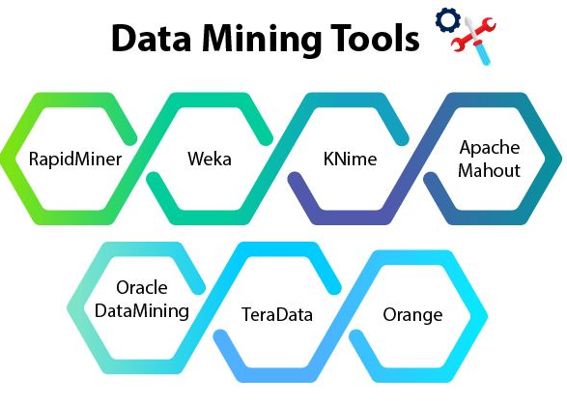
Data mining tools

Slide 18
Data mining tools
1- Rapid Miner: It is a free open-source platform that has hundreds of algorithms for data preparation such as machine learning, deep learning, text mining, and predictive, It has pre-build models that allow non-programmers to deal with it easily just by drag and drop, it also has extensions like R and Python.This tool has employees that are ready to help users at any time.Using the free plan you can analyze up to 10,000 rows of data.
2- IBM SPSS Modeler: This tool allows for data preparation, statistical analysis, and predictive modeling, It is also so helpful to people who have no programming skills because it also allows the drag-and-drop feature, It can handle a big data set from different sources such as Excel, SQL databases, etc... , The standard version of this tool can just deal with numeric data
3- Weka: It is an open-source software, and it has a big collection of algorithms for data mining, It is written in JavaScript language. This tool has built-in machine-learning models so you don’t need to waste time writing code
4- Orange: This tool provides data visualization, Machine learning, Data mining, All these without having programming skills. (everything is drag and drop), It supports various formats such as CSV, Excel, and Database, It has a lot of visualization graphs and also by dragging the widget you can use it, It has Additional categories such as image mining and text mining, it also supports models for supervised and unsupervised data.
(MonkeyLearn, 2020)

Slide 19
Data mining tools
Tools | Rapid Miner | IBM SPSS Modeler | Weka | Orange
Best Suited For | Data Processing and Analytics | Advanced Users | Machine Learning | Beginners
Strengths | Complex data | Advanced statistical analysis, predictive modeling | Suitable for educational purposes | User-friendly, focused on data visualization
Pricing | Free basic version, paid enterprise | Primarily paid, costly | Free and open-source | Free and open-source
(MonkeyLearn, 2020)

Slide 20

Organization.
Jordan Aircraft Maintenance Limited (Joramco)

Slide 21

Organization Information
Organization name: Jordan Aircraft Maintenance Limited (Joramco).
Location: In Jordan, Amman, at the Qween Alia International Airport.
Services: It offers a lot of sevices for aircraft models like Airbus, Boeing and others.
It serves services across the Middle East, Europe, South Asia, Africa, and other regions.
Contact:
Muath Sarayreh
msarayreh@joramco.com.jo
07 9750 0508

Slide 22
Traditional and modern approaches
Traditional Approaches: Joramco's first traditional data management strategy comprised simple databases and manual procedures, which resulted in weak, at-risk-to-mistake operations with no analytical power. This method limited effective decision-making and the capacity to effectively utilize data.
Modern Approaches: Joramco made the shift to modern methods by using modern technologies for dynamic reporting, real-time analytics, and automated data integration. This change improved operational effectiveness, scalability, and decision-making, creating an environment based on data ready for future expansion and technology innovations.

Slide 23
Building blocks of Traditional Approach
1-Manual Data Collection and Entry: Manually recording and entering data into systems frequently resulted in difficult processes and the possibility of human mistake.
2-Basic Databases: Using basic databases systems such Oracle database system, these databases frequently struggled with high quantities or complex information queries due to their limits in complexity and scalability.
3-Simple Querying and Reporting: the data was manually uploaded to databases basic SQL queries were used to get data, and generate data using Excel and results were static and frequently manually exported to spreadsheets.
4-Siloed Data Systems: There were difficulties in exchanging and integrating information since data was stored in separate systems in each departments.
5-Paper-Based Documentation: A large portion of the records were kept on paper, which meant that accessing past data required physical storage and human sorting.
6-Limited Analytics: Basic descriptive data were the only analytics available, giving just a basic view of historical performance and without predictive insights, deeper insights that may have influenced future plans and choices were lost due to a lack of accurate analytics tools.

Slide 24
Building blocks of Modern Approach
1-Automated Data Collection and Integration: Data collecting is automated by modern technology, which decreases human error and speeds procedures, this lead to accurate information perspective, improving the accessibility and dependability of data.
2-Advanced Databases and Storage Solutions: Modern databases, such as NoSQL and cloud storage, provide scalable, adaptable ways to manage varied, massive data sets efficiently.
3-Advanced Reporting and Analytics: Advanced reporting tools allow dynamic, interactive visualizations by using Tablea and Microsoft Power BI, and immediate analytics provide instant insights that speed up decision-making.
4-Cloud Computing: Cloud systems offer flexible and economical on-demand resources for processing and storing data. These resources are scalable.
5- Data Integration and Management Platforms: The creation of a data warehouse by Joramco is a prime instance of contemporary data integration, integrating many technologies for a comprehensive viewpoint, they combined data from several apps using ETL procedures, which increased consistency and decreased redundancies.
7. Liberalizing Data and Self-Service BI: Staff members may now access data and reports directly because of Joramco's transition to self-service BI, made possible by the company's use of SQL Server Reporting Services and other advanced technologies.
8-Flexibility and Constant Improvement: Joramco's continuing shift from outdated structures to more modern ones is reflective of its commitment to continued development and staying up to date with new technologies which makes sure Joramco stays competitive and responsive throughout the ever-changing MRO industry.

Slide 25
Benefits
1-Improved Decision Making: Through data mining, Joramco was able to turn useful findings from big data sets into insights that could be put to use.
2- Enhanced Efficiency and Performance: Efficiency was greatly enhanced by switching from costly, manual operations to automated data mining. Real-time analytics and automated reporting decreased the time required to provide insights and made it possible to react more quickly to new patterns in data.
3-Cost Savings: More efficient data analysis would enable Joramco to find and reduce waste, such needless material orders. The $50K needless order that was avoided serves as an example of large immediate cost reduction.
4- Enhanced Quality of Service: Aircraft were maintained effectively and efficiently because to improved maintenance scheduling made possible by data mining, which increased service reliability.
5- Freedom and Self-Growth: Employees at different levels were able to independently access and evaluate data through data mining tools, which speed up their responses and decision-making.

Slide 26

Text Mining

Slide 27
What is Text Mining?
Text mining: It is the process of taking a lot of unstructured text data and turning it into helpful information by turning it into structured data. In this technique, text is analyzed to find patterns, trends, and relevant information using a variety of technologies and approaches such as:
Machine learning, Statistical analysis, and Natural language processing (NLP).

Slide 28
Text mining process
Data Collection:
Pre-processing: this contains tokenization, Removing Stop Words, and Stemming and converting all the words to lowercase
Analysis: Using algorithms and techniques, particularly Natural Language Processing (NLP) so we can find patterns
Interpretation: which means it will used in decision-making processes

Slide 29
Real-life examples:
Healthcare: Using text mining on patient medical information allows doctors to find patterns and relationships in patient symptoms and treatment, which allows doctors to predict diseases by common symptoms between patients.
Customer serves: Using text mining on a library website, allows customers to know what this library has books about the needed topic just by searching for a specific topic while customers at home
Risk management: Text mining for carefully examining contracts and legal documents to make sure they conform to laws and regulations.
(IBM, 2021)

Slide 30
Text mining tools that are used each sector
Sectors | Tools | Describtion
Healthcare | cTAKES | created to extract data from electronic medical records.
 | BioBERT | It is a biomedical text mining program based on BERT, specifically for medical research documents.
Customer service | RapidMiner | Have the ability to analyze data about interactions with customers.
 | Dialogflow (Google) | AI technology to translate client queries to help chatbot conversations.
Risk management | SAS Text miner | Focus on identifying fraud and tracking compliance.
(IBM, 2021)

Slide 31
Data mining algorithms
Classification Algorithms
Clustering Algorithms
Association Rule Learning
Regression Algorithms
(Valcheva, 2020) (GeeksforGeeks, 2023) (upGrad blog, 2018)

Slide 32
1-Classification Algorithms:
Naive Bayes Classifier: It is utilized to divide text into several classes according to probability.
EX: https://www.geeksforgeeks.org/naive-bayes-classifiers/
Support Vector Machines (SVM): It is the most accurate classification algorithm for text mining and It is useful for finding outliers and problems such as detecting spam.
2-Clustering Algorithms:
Used for grouping a set of objects.
Hierarchical clustering.
K-mean.
(Valcheva, 2020) (GeeksforGeeks, 2023) (upGrad blog, 2018)

Slide 33
3-Association Rule Learning:
Used to identify relationships between variables in large databases.
Apriori algorithm.
4-Regression Algorithms:
Used to predict a range of numeric values based on historical data.
Linear regression.
Logistic regression.
(Valcheva, 2020) (GeeksforGeeks, 2023) (upGrad blog, 2018)

Slide 34
Data mining techniques:
1-Data Preprocessing: cleaning data
2-Data Transformation: transforming data into an analysis-ready format
3-Feature Selection: Selecting the features that are most important for analysis
4- Information Extraction: It divides text into tokens and takes just the important words by the task of IE which makes Feature selection -> Feature extraction -> Named entity recognition it extracts entities from the text and analyzes their relationships but it just works with names.
(Tyagi, 2022) (Vyas, 2023)

Slide 35
Data maining techniques:
1-Topic Analysis:It finds the main topic in a document and helps in subject-based data organization.
2-Sentiment Analysis: Classifies text as positive, negative, or neutral based on the emotional tone of the text in order to determine opinions.
3-Language Detection: identifies a text's language, making it possible to efficiently classify and route customer support questions to employees who are familiar with this language.
5-Model Selection: Selecting the best model for the particular data mining task
6-Data Visualization: Finding patterns and trends in data by utilizing visual representations.
6- Text classification: which is divided into 3 forms:
(Tyagi, 2022) (Vyas, 2023)

Slide 36
Data mining methods:
Descriptive Analysis: Recognizing and condensing a dataset's main features.
Summarization: putting a lot of text into a brief summary.
Frequency Analysis: counting words, sentences, or subjects to find the components that appear most frequently.
Correlation Analysis: examining connections or correlations between various phrases or ideas in the text.
Predictive Analysis: Making predictions about the future based on past data.
Sentiment Analysis: making sentiment predictions for future texts by using patterns discovered from annotated previous data.
Classification Models: Using labeled example training to predict the classification of unseen documents.
Trend Analysis: predicting patterns for the future by looking at how certain subjects or phrases have appeared in the past.
(Simplilearn, 2023) (PPT, 2018)

Slide 37
Aproaches of data mining
Supervised learning: Algorithms are trained on labeled data in order to predict or classify.
Unsupervised learning: Without labels, find patterns; they are algorithms frequently applied to anomaly detection and clustering.
Semi-supervised learning: merges labeled and unlabeled data for regression and classification applications.
(Simplilearn, 2023) (PPT, 2018)

Slide 38
TF – IDF
What is TF (Term Frequency): It shows the number of repetitions of each word in each document, divided by the total number of words in that document
What is IDF (Inverse Document Frequency): This calculates the frequency of each word throughout all documents.
What is TF-IDF: it gives each word a weight that shows the importance of the word in each document.
(Author: Fatih Karabiber Ph.D. in Computer Engineering et al., 2017) (MonkeyLearn Blog, 2019)

Slide 39
TF – IDF is used to calculate measures
Cosine Similarity: an angle formed by two vectors. used to compare the similarity of two documents or objects, regardless of size
Manhattan Distance: the total of the absolute differences in coordinates between two places to find their distance.
Euclidean Distance: The straight distance in space between two points
(Author: Fatih Karabiber Ph.D. in Computer Engineering et al., 2017) (MonkeyLearn Blog, 2019)

Slide 40
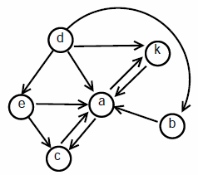
Graph Mining

Slide 41
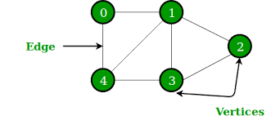
What is Graph Mining?
Graph mining: is a filed of data analytics, its a way to extract useful information and patterns and relationships from graphs
Graphs: are is usually made of nodes and edges, the graph could be directed or not directed based on the scenario, also, graphs are usually used to show complex networks such as social networks, and communication networks
(Xi'an University, 2018)

Slide 42
Real-life examples:
Social networks: Examining the relationships between users on social media sites like Facebook or LinkedIn in order to suggest new friends.
Healthcare: Mapping and examining how illnesses travel throughout populations in order to manage growing routes like what happened in Covid 19.
Transportation and Logistics: Decreasing travel times and expenses by evaluating road and airline networks to find the best routes like UPS delivery company, this company used an advanced graph mining algorithm to make their work more professional, this system is known as On-Road Integrated Optimization and Navigation (ORION), This advanced system shows how much left turns, traffic conditions, climate, and even the amount of time needed to open and close car doors and walk to the customer door.
(Xi'an University, 2018)

Slide 43
How graph mining algorithms work?
Preprocessing: Preprocessing can be necessary to transform data into a graph format that can be analyzed.
Graph Representation: represent the data as edges (relationships) and nodes (entities).
Pattern Discovery: this can assist in locating common behaviors or similar characteristics in the data.
Importance Measurement:
Anomaly Detection: Algorithms search for strange trends or surprising connections that differ from the norm and may indicate mistakes.
Predictions: Based on existing patterns and trends, algorithms may attempt to forecast connections in the future or the graph's development.
(Tutorial - Network, 2022) (Kanti Kumar et al., 2023)

Slide 44
Importance Measurement that assess how graph mining algorithms work?
PageRank: is employed in a network to determine which nodes are the most crucial. It uses the idea that connections from nodes with higher rankings are more important to determine each node's relevance.
Degree Centrality: This measure highlights the most active or most popular nodes in the network by identifying the nodes with the most connections
Closeness Centrality: indicates the speed at which a node may connect to every other node in the network.
Betweenness Centrality: This measure finds the nodes in the network that serve as essential bridges with other nodes.
(Kanti Kumar et al., 2023)

Slide 45
Programming languages used for graph mining:
Python: it is used because this language has a lot of libraries for graph mining such as NetworkX, Graph-tool, and PyGraphviz.
Java: It is used because of its performance and because it can handle huge graphs, also it has helpful libraries such as JGraphT and Apache Giraph.
R: It is used because it provides a full environment for statistical analysis, also it has helpful libraries such as statnet and igraph.
(Katana Graph, 2022)

Slide 46
Graph mining tools used in industry
Cytoscape: It is used in healthcare sectors, especially in Biomedical research, using this tool in this field was helpful for understanding how genes and proteins interact in biology and the base language of this tool is Java.
NetworkX: it is a Python package, it is used in the Academia, Transportation, and Telecommunications sectors, it provides different types of graphs such as (simple graphs, directed graphs, and graphs with parallel edges and self-loops)
Gephi: It is used in the Social Science and marketing sectors and It is an open-source software, also it is used for analyzing all kinds of complex networks and the base language of this tool is Java.
(M. Vedanayaki, 2014)

Slide 47
My application:

Slide 48
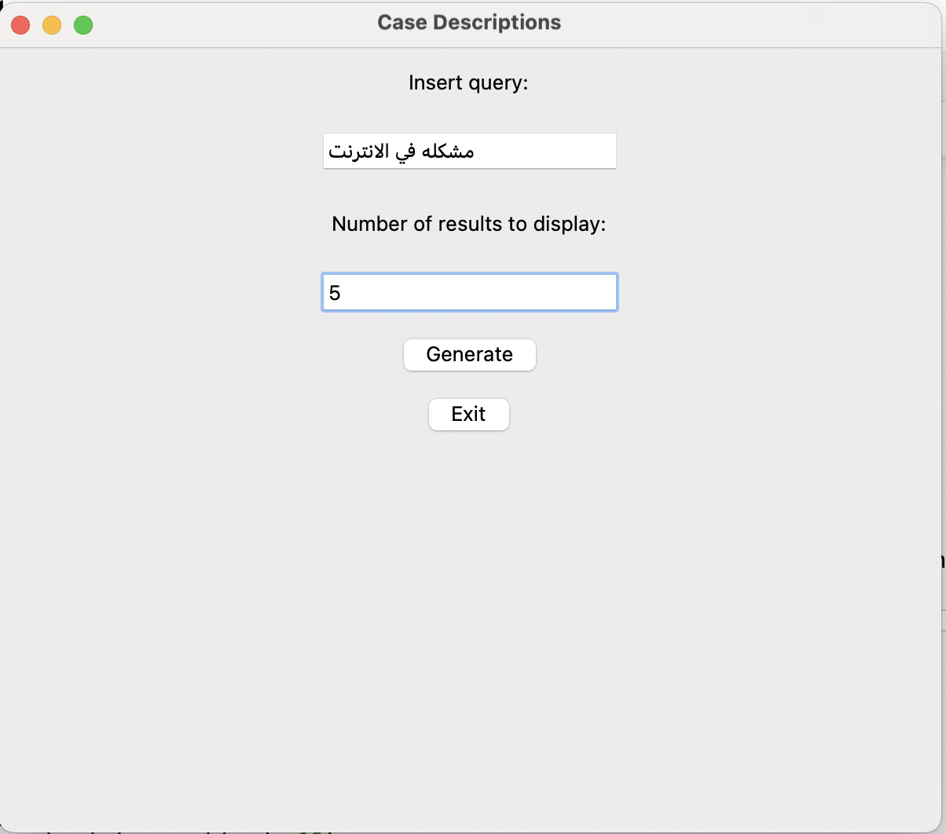
Text mining: Main window:

Slide 49
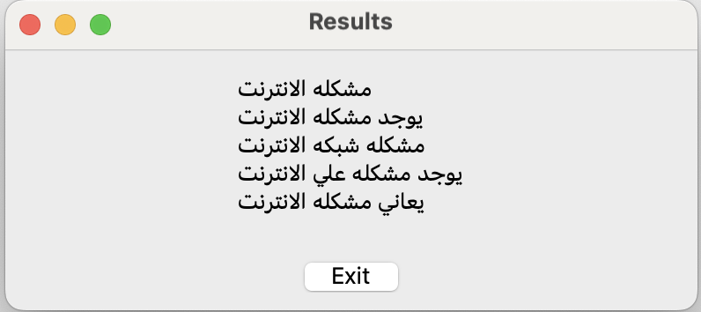
Results:

Slide 50
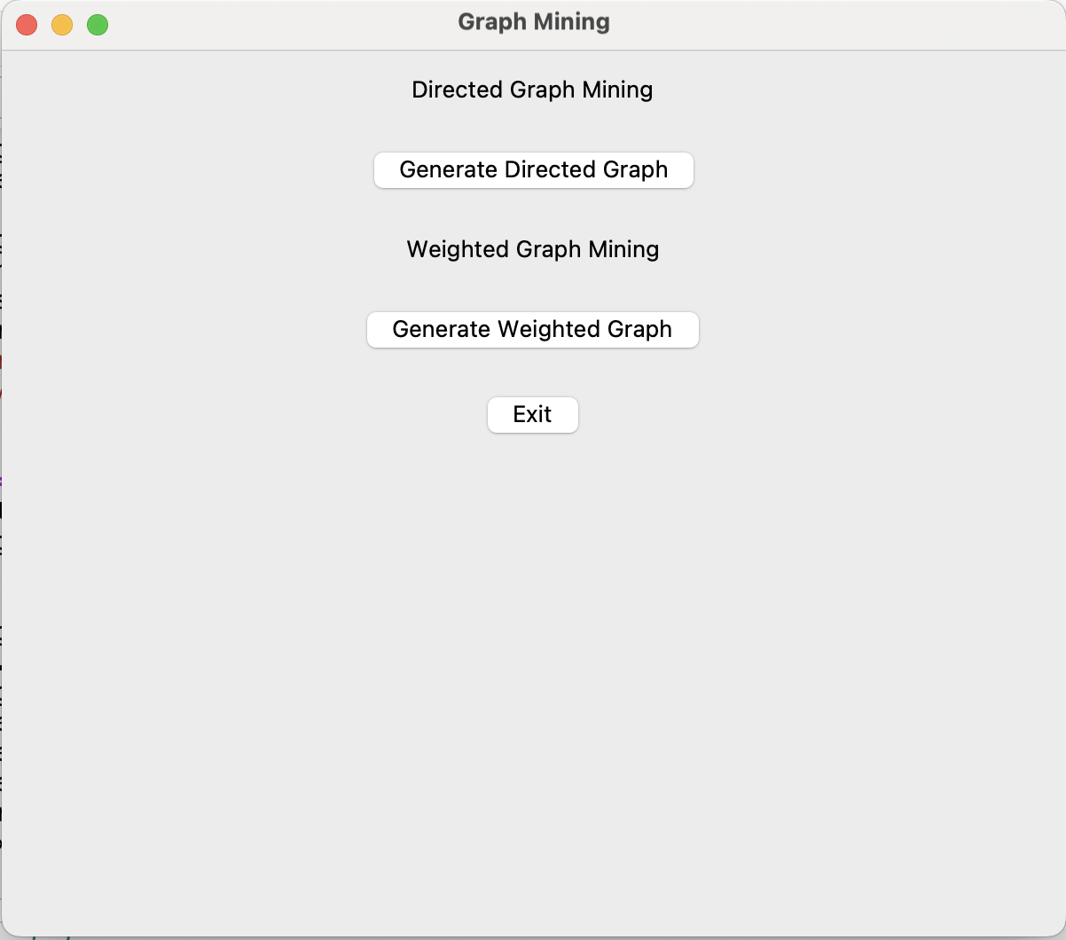
Graph mining: Main window:

Slide 51
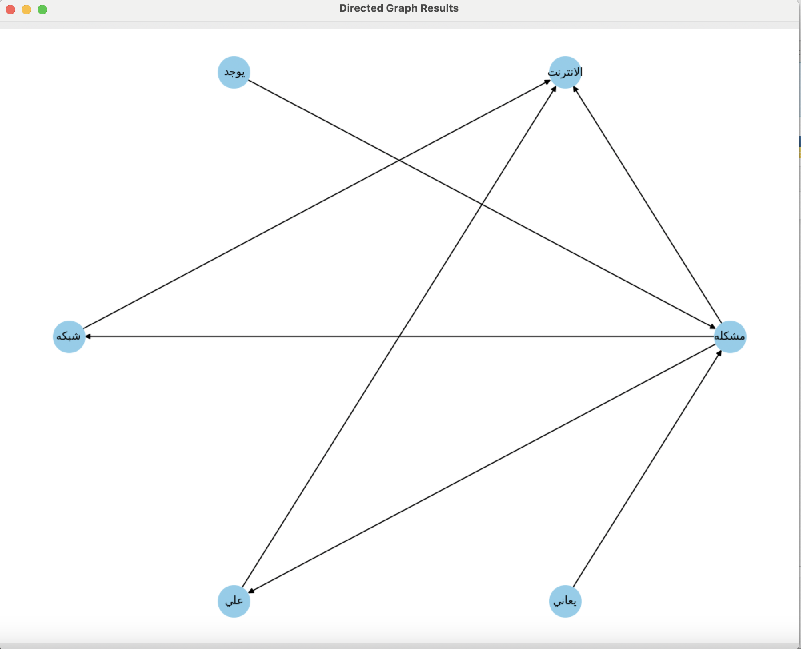
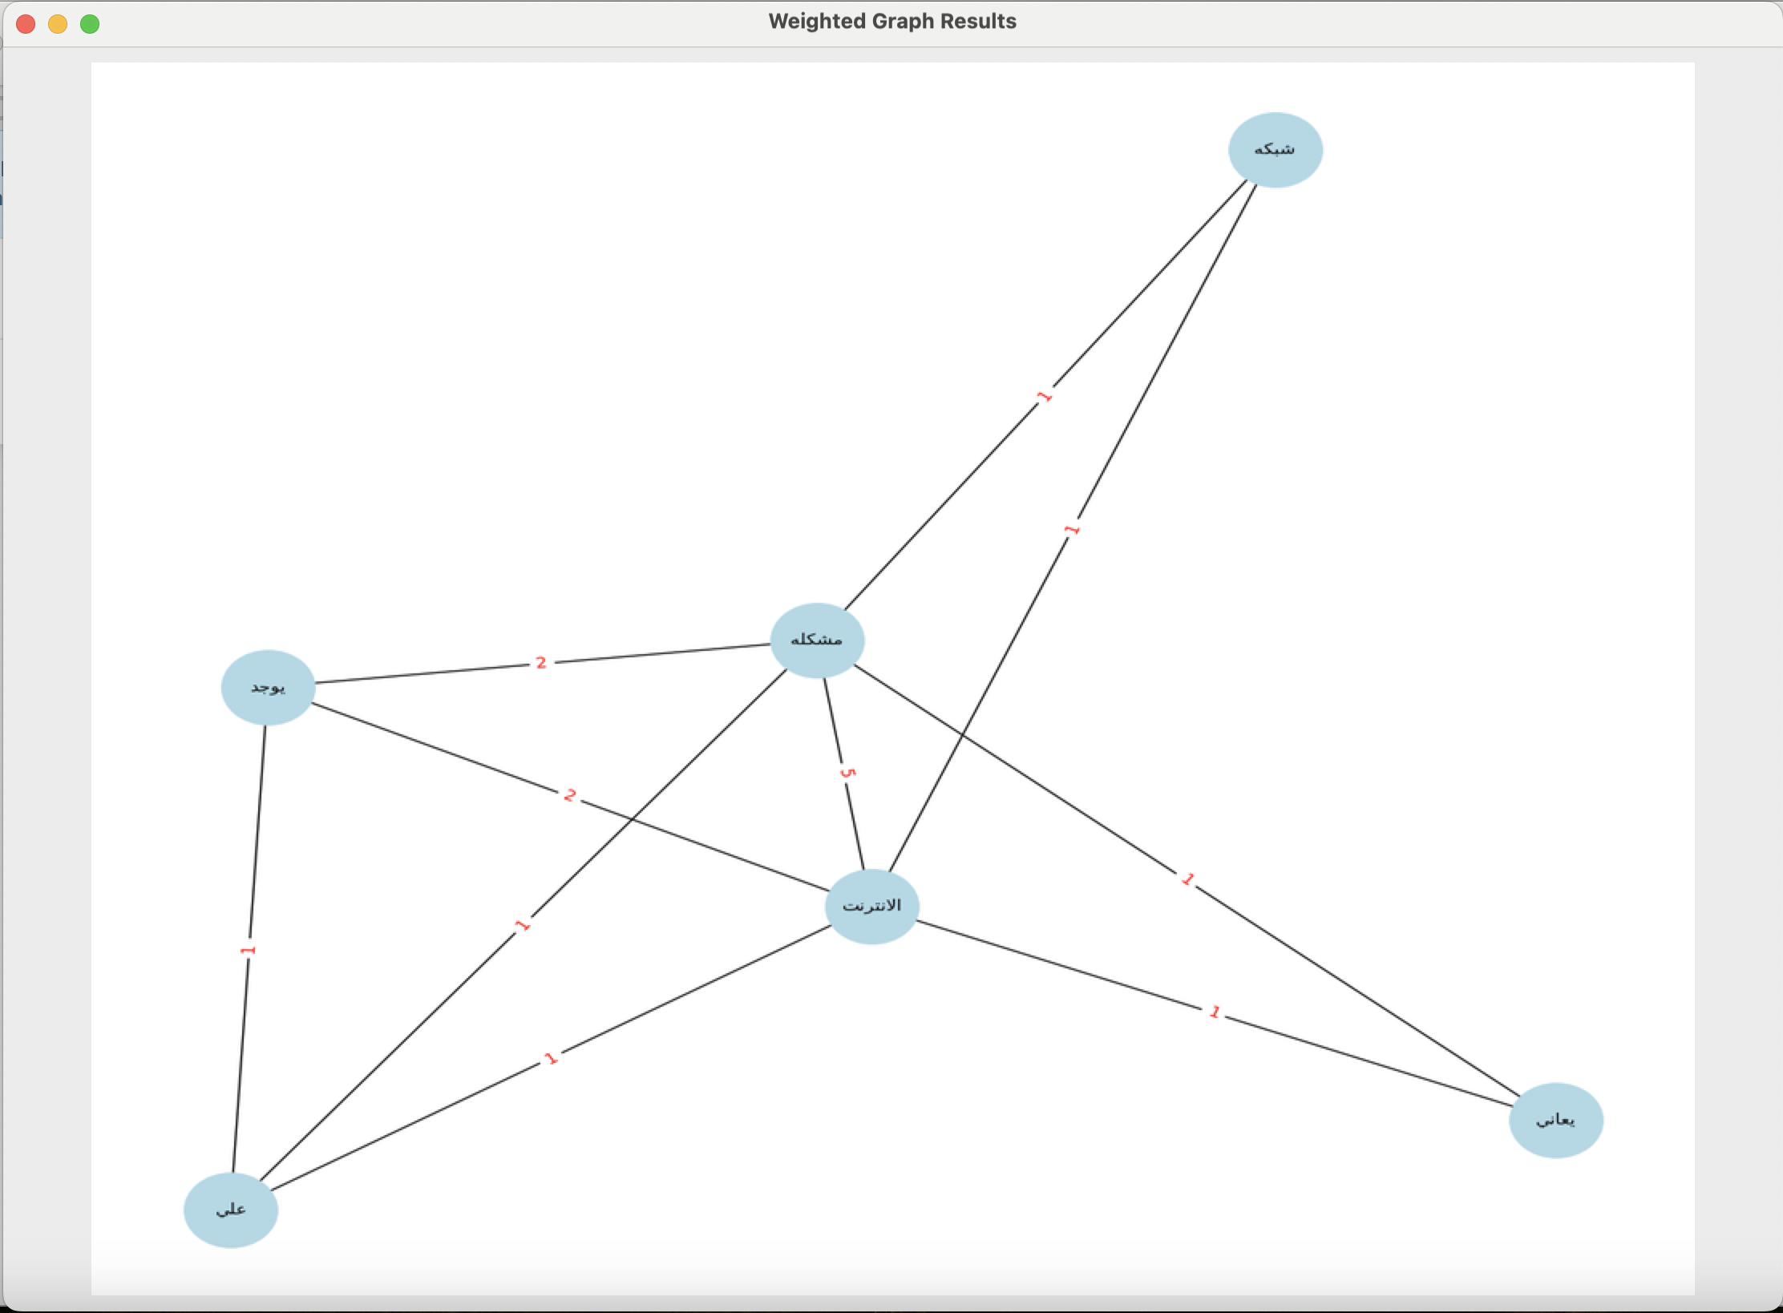
Results:

Slide 52
Referances
Suanfazu et al. (2021) History of data mining, Hacker Bits. Available at: https://hackerbits.com/data/history-of-data-mining/ (Accessed: 30 November 2023).
bootcamp.rutgers (2021) What is data mining? A beginner’s guide (2022), Rutgers Bootcamps. Available at: https://bootcamp.rutgers.edu/blog/what-is-data-mining/#:~:text=History%20of%20Data%20Mining,-Did%20you%20know&text=Through%20the%20Turing%20Universal%20Machine,what%20data%20mining%20is%20today. (Accessed: 30 November 2023).
Exastax (2017) The history of Data Mining, Medium. Available at: https://medium.com/@exastax/the-history-of-data-mining-d2aeb0f587ce (Accessed: 30 November 2023).
MonkeyLearn (2020) 10 Best Data Mining Tools in 2022, MonkeyLearn Blog. Available at: https://monkeylearn.com/blog/data-mining-tools/ (Accessed: 05 December 2023).
IBM (2021) What is text mining?, IBM. Available at: https://www.ibm.com/topics/text-mining (Accessed: 05 December 2023).
Xi’an University (2018) ITU Workshop on ‘economic and fiscal incentives to accelerate digital transformation of data and applications over telecommunication infrastructure’, ITU. Available at: https://www.itu.int/en/ITU-T/Workshops-and-Seminars/2022/1103/Pages/default.aspx (Accessed: 05 December 2023).
Valcheva, S. (2020) Text mining algorithms list: Text classification categorization clustering, Blog For Data-Driven Business. Available at: https://www.intellspot.com/text-mining-algorithms/ (Accessed: 05 December 2023).
GeeksforGeeks (2023) Naive Bayes classifiers, GeeksforGeeks. Available at: https://www.geeksforgeeks.org/naive-bayes-classifiers/ (Accessed: 05 December 2023).
Tyagi, N. (2022) 7 text mining techniques: Analytics steps, 7 Text Mining Techniques | Analytics Steps. Available at: https://www.analyticssteps.com/blogs/top-7-text-mining-techniques (Accessed: 05 December 2023).
M. Vedanayaki (2014) Indian Journal of Science and Technology, Consequence of Cross Cultural ... Available at: https://sciresol.s3.us-east-2.amazonaws.com/IJST/Articles/2014/Issue-Supplementary-7/Article2.pdf (Accessed: 05 December 2023).
Kanti Kumar, P., Dutta, A. and Kumar, P. (2023) Application of graph mining algorithms for the analysis of web data, SSRN. Available at: https://papers.ssrn.com/sol3/papers.cfm?abstract_id=4365862#:~:text=The%20graph%20is%20used%20in,networks%2C%20social%20networks%2C%20etc. (Accessed: 23 December 2023).
Tutorial - Network (2022) Tutorial#, Tutorial - NetworkX 3.2.1 documentation. Available at: https://networkx.org/documentation/stable/tutorial.html (Accessed: 23 December 2023).
Katana Graph (2022) The language of graph: Graph Mining, Smart data insights. Available at: https://blog.katanagraph.com/the-language-of-graph-graph-mining (Accessed: 23 December 2023).

Slide 53
Referances
MonkeyLearn Blog (2019) Understanding TF-ID: A simple introduction, MonkeyLearn Blog. Available at: https://monkeylearn.com/blog/what-is-tf-idf/ (Accessed: 23 December 2023).
Author: Fatih Karabiber Ph.D. in Computer Engineering et al. (2017) TF-idf - term frequency-inverse document frequency, Learn Data Science - Tutorials, Books, Courses, and More. Available at: https://www.learndatasci.com/glossary/tf-idf-term-frequency-inverse-document-frequency/#:~:text=Using%20scikit%2Dlearn-,What%20is%20TF%2DIDF%3F,%2C%20relative%20to%20a%20corpus). (Accessed: 23 December 2023).
PPT (2018) Data Mining Approaches and methods, PPT. Available at: https://www.slideshare.net/sonangrai/data-mining-approaches-and-methods-108692929 (Accessed: 23 December 2023).
Simplilearn (2023) Types of data mining techniques: Simplilearn, Simplilearn.com. Available at: https://www.simplilearn.com/types-of-data-mining-techniques-article (Accessed: 23 December 2023).
Vyas, K. (2023) Data Mining: 6 essential techniques, Datamation. Available at: https://www.datamation.com/big-data/data-mining-techniques/ (Accessed: 23 December 2023).
upGrad blog (2018) Top 10 most common data mining algorithms you should know, upGrad blog. Available at: https://www.upgrad.com/blog/common-data-mining-algorithms/ (Accessed: 23 December 2023).
Stedman, C. and Hughes, A. (2021) What is data mining?, Business Analytics. Available at: https://www.techtarget.com/searchbusinessanalytics/definition/data-mining#:~:text=Data%20mining%20is%20the%20process,make%20more%2Dinformed%20business%20decisions. (Accessed: 23 December 2023).
Center, H.M.N.R. et al. (2000) Theoretical frameworks for Data Mining, ACM SIGKDD Explorations Newsletter. Available at: https://dl.acm.org/doi/10.1145/846183.846191 (Accessed: 23 December 2023).

